Slide 1
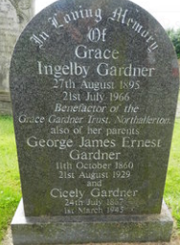
Grace Ingleby* Gardner
1895 - 1966

Slide 2
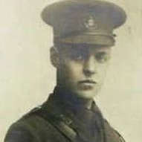
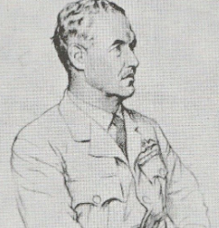
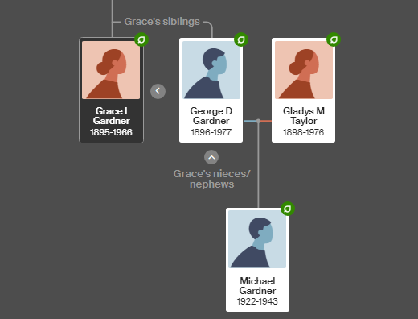
Grace’s Brother
Wing Commander George Dudley Gardner OBE MC
B 1896 Northallerton
D 1977 Dublin
M Gladys Marjorie Taylor (1898-1976)
Their son: Sergeant Michael Gardner
B 1922
D 1943: 1656 HCU's Avro Lancaster (#ED381)
Bomber aircraft, with an aircrew of seven, took off from RAF Lindholme for a night cross-country training exercise flight. ED381 collided in mid-air with 27 Operation Training Unit's (OTU) Vicker Wellington (#BJ845), crashing near Highworth in Swindon, Wiltshire and taking the lives of the entire crew.

Slide 3
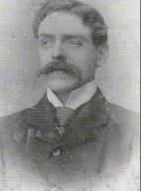
Grace’s Parents
Cicely Jefferson
B 1867 Northallerton
D 1945 Northallerton
In 1939 she and Grace lived together at Alverton, South Parade
George James Ernest Gardner
B 1860 Leith, Scotland
D 1929 Darlington
Moved from Scotland to Northallerton between 1861 and 1871 when his father became Governor or Northallerton Prison; he took his law exam in 1880, and in 1881 he was working in Northallerton as a solicitor's clerk, later as a solicitor.

Slide 4
Grace’s Paternal family
Grandparents (married Dublin 1847)
George Dudley Gardner (B 1823 Hatfield Peveral, Essex - D 1895 Northallerton) Governor of HMP Northallerton, but a career civil servant - children born Treland, Scotland, England as he moved for work
Selina Elizabeth Wathen (B 1831 Maidstone - D 1926 West Horsham)
George JE was the fifth of their six children
Isabella Jane Gardner 1849–
Arthur John Gardner 1851–1930
Lillian Gertrude Gardner 1854–1926
Caroline Ann Gardner 1858–1942
George James Ernest Gardner 1860–1929
Charles Edward Gardner 1863–1865

Slide 5
Paternal aunts and uncles
Isabella Jane Gardner - married James Bailey Peacock, a GP from Leeds
  George G Peacock 1869-1894 - found no records of marriage or children
  Selina W Peacock 1871-1875
  Daisy ED Peacock 1873 - found no records after 1891 census but some researchers show her married to William Irving Bond (I have found no records to confirm this)
  Carine Ida Peacock 1874-1891
  Ivy Gertrude Peacock 1876 - found no records after baptism
Arthur John Gardner, doctor - m Mary Abbey, no children
Lillian Gertrude Gardner - no record of marriage or children
Charles Edward Gardner - died aged 2

Slide 6
Paternal aunts and uncles (continued)
Caroline Ann Gardner - m Frederick Malcolm Hurdis Jones
  Malcolm Dudley Hurdis Jones 1884- m Rosa Leslie
    Frederick Patrick Malcolm Hurdis-Jones 1923-1997, found no record of marriage or children
  Kathleen M Hurdis-Jones 1889- m Charles Mason
    Sir Dan Hurdis Mason OBE 1911-1982, m Lady Joyce Louise Nutt
      Jill Mary Mason 1935-1985, m Robert Shiers
        2 children, 5 grandchildren
      Edward James Hurdis Mason and/or
      Charles Young Hurdis Mason 1934-1999, M Angela Hollloway
        3 children
      Dan Richard Mason 1940-2013 - unable to trace forward

Slide 7
Grace’s Maternal family
John Ingleby Jefferson 1853–1929
William Dixon Jefferson 1856–1927
Robert Ingleby Jefferson 1857–
Arthur Jefferson1860–1892
Mary Jefferson 1862
Charles Wilkin Jefferson 1863–1956
Annie Jefferson 1866–
Margaret Elizabeth. Jefferson 1871–1943
Florence Jefferson 1874–1945
Grandparents (married 1852, Clapham)
William Thrush Jefferson (B1820 Northallerton - D 1891 Northallerton) - Solicitor Registrar to Northallerton County Court
Margaret Ingleby (B 1828 Clapham (Austwick) - D 1913 Northallerton)
Cicely was the eighth of ten children

Slide 8
Maternal aunts and uncles
John Ingleby Jefferson, solicitor - 1911 census shows him living with his mother (Standard House), single
William Dixon Jefferson, surgeon - married Mary Stuart Gray in 1892 (Gloucestershire), lived in Ripon. Two sons:
  Ingleby Stuart Jefferson, 1893-191 - Ingleby Stuart Jefferson, Lieutenant Royal Navy. Aged 24 years. Killed in action when in command of H.M. Submarine C34 in the North Sea, 21 July 1917. Elder son of Dr William Dixon and Mary Stuart Jefferson, or North House, Ripon. Great Grandson of Revd William Gray, Canon Residentiary of this Cathedral (1829-1863), and of Robert Ingleby, Lawkland Hall, Yorkshire. Burial: Ripon Cathedral
  Brigadier Julian Jefferson CBE, 1899-1966 - married twice
    1 child, 1 grandchild

Slide 9
Maternal aunts and uncles (continued)
Robert Ingleby Jefferson, bank manager - married Arabella Ward in 1899; found no record of children
Mary Jefferson - m Dr Sylvester Richmond
  Arnold Ingleby Richmond, 1887-1971, married three times
    Louise Richmond,1929- , m Gerald Lambert
      2 children
    Dau (1930s)
  Sylvia Richmond, 1892-1977, m Frederick Lucas King, 2 children

Slide 10
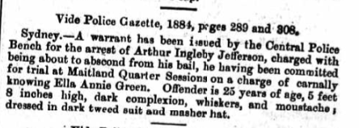
Maternal aunts and uncles (continued)
Arthur Jefferson, possibly the AF apprenticed to the Merchant Navy aged 12, married Georgia Pearoth, Virginia 1886
  Daughter Dorothy Margaret Lennox Jefferson (1888-1982), married Edward Gilling Hallewell
    Lt John Lennox Hallewell, 1910 - 1940 HMS Glorious, Sunk by Scharnhorst and Gneisenau 8th June 1940
    Helen Mary Josephine Hallewell, 1913-1987, m Arthur Farquhar
      Donald CS Farquhar, 1935 - 2009, m Eileen Carter
        1 child
    Anne Cecilia Hallewell, 1915-1943, m Osric Bradbury, found no record of children
    Lt Cdr Christopher Hallewell, 1920-1985, m Ione Bluett-Duff
      2 children

Slide 11
Maternal aunts and uncles (continued)
Charles Wilkin Jefferson, manufacturer - m Margaret Dyer
  Jack Jefferson d.1891
  Margaret Elizabeth Jefferson 1892-1943, m Jesse Gregson
    Helen Ingleby Gregson 1924-2012, m (Stuart) Terry Warliker, found no record of children
  Charles Wilson Jefferson, farmer, 1895-1937, m Dorothy Wright
    John Ingleby Jefferson, 1921-2018, WW2 spitfire pilot, later ran “The Laff” (Chateau Lafeyette - Ottawa’s oldest tavern), m Peggy
      7 children
    Charles Howard Jefferson, 1924-2024, (Queen Elizabeth II Diamond Jubilee Medal) m Marjorie Taggart
      4 children; 10 grandchildren and 12 great-grandchildren
    Catherine Wright Jefferson, 1926-, m David Lewis - unable to trace forward
    Dorothy Anne Jefferson, 1928- unable to trace forward
    David Forties Jefferson, 1929- unable to trace forward

Slide 12
Maternal aunts and uncles (continued)
Annie Jefferson - m Arthur Dewhurst,
  Joan Ingleby Dewhurst 1890-1986, no marriage or children
  Nancy Stevenson Dewhurst 1900- m Stewart Marshall
    Elizabeth Ray Marshall, 1926-2002, no marriage or children
Margaret Elizabeth Jefferson - m Harry Yeoman
  Ruth Yeoman, 1897-1994, served in the WVS, thereafter a missionary; no marriage or children
  Harry Dixon Yeoman, 1904-1904
  Cdr Antony Yeoman RN, 1907-1966, found no record of marriage or children
Florence Jefferson - m Stewart Dalrymple Crawford
  Frazer Stuart Crawford 1901-1981, merchant - m Ruth Massey
    Moira Crawfod MBE 1928-1987, no marriage or children
    Carol Crawford 1930- unable to trace forward
  David Stewart Crawford, 1904-1952 - m Margaret Craig. Died together in the Turf Club Massacre (Cairo) on Black Saturday

Slide 13
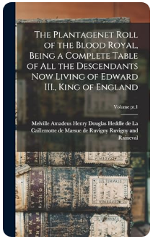
The Plantagenet Roll of the Royal Blood
The Plantagenet roll of the blood royal, being a complete table of all the descendants now living of Edward III., King of England
by Ruvigny and Raineval, Melville Amadeus Henry Douglas Heddle de La Caillemotte de Massue de Ruvigny, 9th marquis of, 1868-1921
Publication date 1911

Slide 14
And finally… a bit of scandal…
Grace Gardner
Cicely Jefferson
Margaret Ingleby
Robert Ingleby
John Abbotson Ingleby
Columbus Ingleby
Thomas Ingleby
Columbus Ingleby
John Ingleby
Thomas Ingleby
John Ingleby of Ripley, Lawkland, Hutton Rudby; Governor of Leith
Cecily Talboys
Elizabeth Gascoigne
Margaret Percy
Henry Percy
Lady Eleanor Neville of Raby
Joan Beaufort
John Of Gaunt / Katherine de Roet King Edward III / Phillipa of Hainault (16th Great Grandparents)

